Slide 1
Inter Process Communication
Yubin Xia
IPADS, SJTU
Credit to Timothy Roscoe, ETH

Slide 2
Cooperating Processes
Independent process cannot affect or be affected by the execution of another process
Cooperating process can affect or be affected by the execution of another process
Advantages of process cooperation
Information sharing
Computation speed-up
Modularity
Convenience

Slide 3
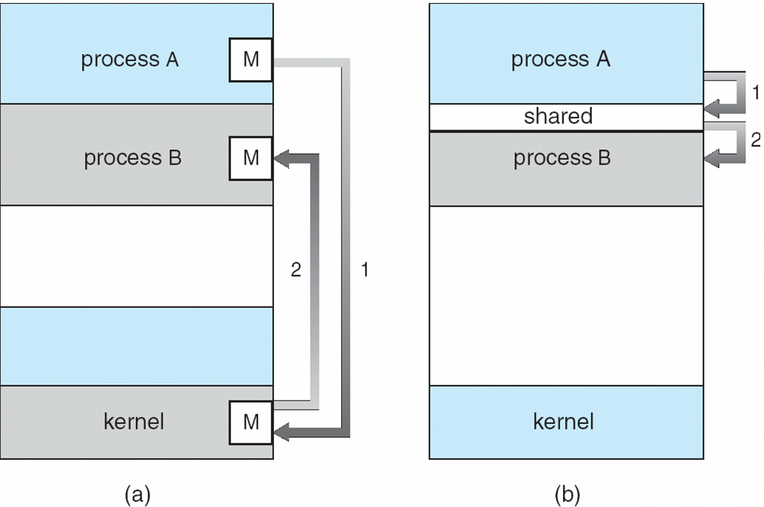
Communications Models

Slide 4
IPC
Cooperating processes need interprocess communication (IPC)
Two models of IPC
Shared memory
Message passing

Slide 5
Producer-Consumer Problem
Producer process produces information that is consumed by a consumer process
unbounded-buffer places no practical limit on the size of the buffer
bounded-buffer assumes that there is a fixed buffer size

Slide 6
Bounded-Buffer – Shared-Memory Solution
Shared data
#define BUFFER_SIZE 10
typedef struct {
. . .
} item;
item buffer[BUFFER_SIZE];
int in = 0;
int out = 0;
Solution is correct, but can only use BUFFER_SIZE-1 elements

Slide 7
Bounded-Buffer – Producer
while (true) { /* Produce an item */
while (((in = (in + 1) % BUFFER SIZE count)
== out)
; /* do nothing -- no free buffers */
buffer[in] = item;
in = (in + 1) % BUFFER SIZE;
}

Slide 8
Bounded Buffer – Consumer
while (true) {
while (in == out)
; // do nothing -- nothing to consume
// remove an item from the buffer
item = buffer[out];
out = (out + 1) % BUFFER SIZE;
return item;
}

Slide 9
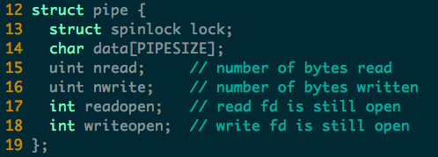
Example of IPC in xv6: Pipe (pipe.c)

Slide 10
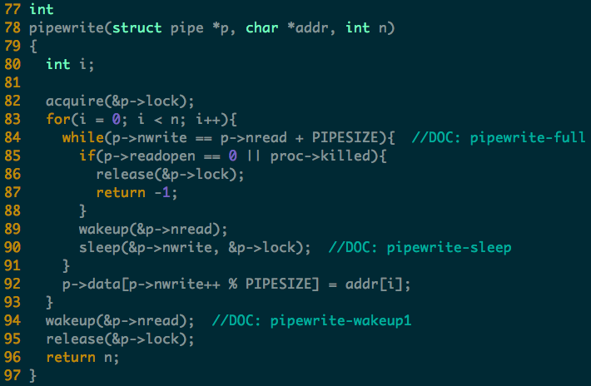
Notes:
Two wakeup here
The first wakeup is since the buffer is full and thus need to be read (previous write).
The second wakeup is similar, ask to read the (current write).
Note: sleep with lock

Slide 11
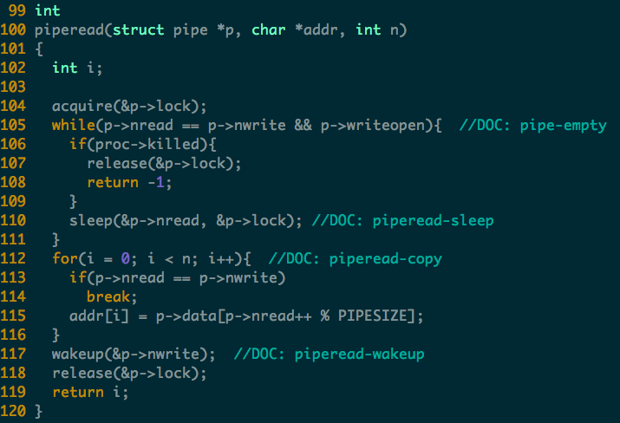
Notes:
Why only one wakeup(writer) here?
In the while loop, no need to wakeup writer since the buffer is empty and no write will sleep
After the for loop, some writer may be waiting (e.g., the buffer was full before read), so wake them up.

Slide 12
Interprocess Communication – Message Passing
Mechanism for processes to communicate and to synchronize their actions
Message system
processes communicate with each other without resorting to shared variables
IPC facility provides two operations:
send(message) – message size fixed or variable
receive(message)

Slide 13
Message Passing (Cont.)
If P and Q wish to communicate, they need to:
establish a communication link between them
exchange messages via send/receive
Implementation of communication link
physical (e.g., shared memory, hardware bus)
logical (e.g., logical properties)

Slide 14
Implementation Questions
How are links established?
Can a link be associated with more than two processes?
How many links can be between every pair of communicating processes?
What is the capacity of a link?
Is the size of a message that the link can accommodate fixed or variable?
Is a link unidirectional or bi-directional?

Slide 15
Direct Communication
Processes must name each other explicitly:
send (P, message) – send a message to process P
receive(Q, message) – receive a message from process Q
Properties of communication link
Links are established automatically
A link is associated with exactly one pair of communicating processes
Between each pair there exists exactly one link
The link may be unidirectional, but is usually bi-directional

Slide 16
Indirect Communication
Messages are directed and received from mailboxes (also referred to as ports)
Each mailbox has a unique id
Processes can communicate only if they share a mailbox

Slide 17
Indirect Communication
Properties of communication link
Link established only if processes share a common mailbox
A link may be associated with many processes
Each pair of processes may share several communication links
Link may be unidirectional or bi-directional

Slide 18
Indirect Communication
Operations
create a new mailbox
send and receive messages through mailbox
destroy a mailbox
Primitives are defined as:
send(A, message) – send a message to mailbox A
receive(A, message) – receive a message from mailbox A

Slide 19
Indirect Communication
Mailbox sharing
P₁, P₂, and P₃ share mailbox A
P₁, sends; P₂ and P₃ receive
Who gets the message?
Solutions
Allow a link to be associated with at most two processes
Allow only one process at a time to execute a receive operation
Allow the system to select arbitrarily the receiver. Sender is notified who the receiver was.

Slide 20
Synchronization & Asynchronous
Message passing may be either blocking or non-blocking
Blocking is considered synchronous
Blocking send has the sender block until the message is received
Blocking receive has the receiver block until a message is available
Non-blocking is considered asynchronous
Non-blocking send has the sender send the message and continue
Non-blocking receive has the receiver receive a valid message or null

Slide 21
Buffering
Queue of messages attached to the link; implemented in one of three ways
1. Zero capacity – 0 messages Sender must wait for receiver (rendezvous)
2. Bounded capacity – finite length of n messages Sender must wait if link full
3. Unbounded capacity – infinite length Sender never waits

Slide 22
Examples of IPC Systems - POSIX
POSIX Shared Memory
Process first creates shared memory segment
segment id = shmget(IPC PRIVATE, size, S IRUSR | S IWUSR);
Process wanting access to that shared memory must attach to it
shared memory = (char *) shmat(id, NULL, 0);
Now the process could write to the shared memory
sprintf(shared memory, "Writing to shared memory");
When done a process can detach the shared memory from its address space
shmdt(shared memory);

Slide 23
Examples of IPC Systems – WinXP
Message-passing centric via local procedure call (LPC) facility
Only works between processes on the same system
Uses ports (like mailboxes) to establish and maintain communication channels

Slide 24
Examples of IPC Systems – WinXP (cont.)
Communication works as follows:
The client opens a handle to the subsystem’s connection port object
The client sends a connection request
The server creates two private communication ports and returns the handle to one of them to the client
The client and server use the corresponding port handle to send messages or callbacks and to listen for replies

Slide 25
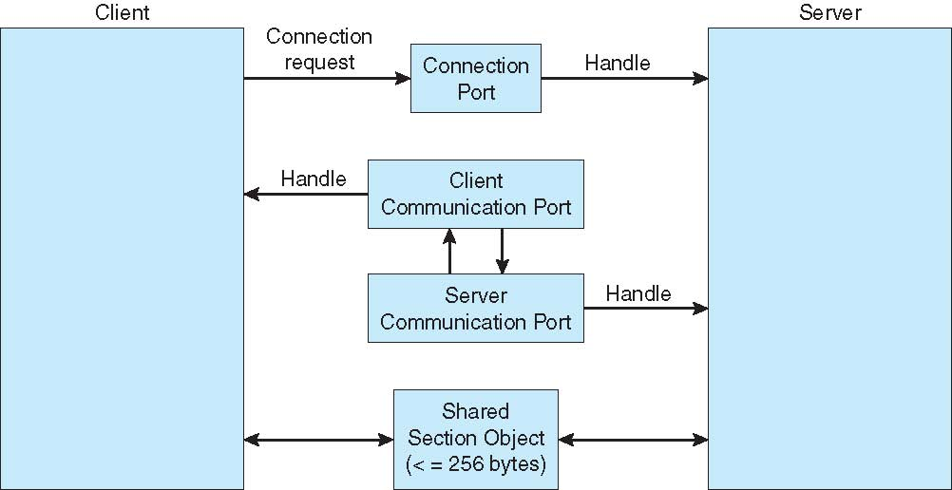
Local Procedure Calls in Windows XP

Slide 26
Communications in Client-Server Systems
Sockets
Remote Procedure Calls
Remote Method Invocation (Java)

Slide 27
IPC in Microkernel

Slide 28
IPC in Microkernel
The microkernel idea
Mach (and others)
The great microkernel debate
Bershad and Chen vs. Liedtke
The design of L3 and L4
Performance and size are everything
Lightweight RPC (LRPC)
Making interprocess calls fast
L4 RPC
Making interprocess calls even faster

Slide 29
Review: Monolithic VS. Microkernel

Slide 30
Early example: Hydra
Separation of mechanism from policy
[Levin et al., 1975]
No hierarchical layering of kernel
Protection, even within OS
Uses capabilities
Objects, encapsulation, units of protection
Can be considered the first object‐oriented OS

Slide 31
Popular example: Mach
Developed at CMU by Rashid and others from 1984 [Rashid et al., 1988]
Goals:
Tailorability: support different OS interfaces
Portability: almost all code H/Windependent
Real‐time capability
Multiprocessor and distribution support
Security
Coined term microkernel

Slide 32
Basic features of Mach kernel
Task and thread management
Inter‐process communication
asynchronous message‐passing
Memory object management
System call redirection
Device support
Multiprocessor support

Slide 33
Mach = μkernel?
Most OS services implemented at user level
Using memory objects and external pagers
Provides mechanisms, not policies
Mostly hardware independent
Big!
140 system calls (300 in later versions), >100 kLOC
Unix 6th edition had 48 system calls, 10kLOC without drivers
200 KiB text size (350 KiB in later versions)
Poor performance
Tendency to move features into kernel

Slide 34
Overview
The microkernel idea
Mach (and others)
The great microkernel debate
Bershad and Chen vs. Liedtke
The design of L3 and L4
Performance and size are everything
Lightweight RPC (LRPC)
Making interprocess calls fast
L4 RPC
Making interprocess calls even faster

Slide 35
Critique of microkernel architectures
“Personally, I’m not interested in making device
drivers look like user‐level. They aren’t, they
shouldn’t be, and microkernels are just stupid.”
‐‐ Linus Torvalds

Slide 36
Microkernel performance
First generation microkernel systems (’80s, early ’90s)
Exhibited poor performance when compared to monolithic UNIX implementations
Particularly Mach, the best‐known example
Typical results:
Move OS services back into the kernel for performance
Move complete OS personalities into kernel
Chorus Unix, OSF/1
Mac OS X (Darwin): complete BSD kernel linked to Mach
Some spectacular failures
IBM Workplace OS, GNU Hurd

Slide 37
Microkernel performance
Reasons investigated [Chen and Bershad, 1993]:
Instrumented user & system code to collect execution traces
Run on DECstation 5000/200 (25MHz MIPS R3000)
Run under Ultrix and Mach with Unix server
Traces fed to memory system simulator
Analyzed memory cycles per instruction:
Baseline MCPI (i.e., excluding idle loops)

Slide 38
Ultrix vs. Mach+Unix MCPI

Slide 39
Interpretation
Observations:
Mach memory penalty higher
i.e. cache misses or write stalls
Mach VMsystem executes more instructions than Ultrix
but is portable and has more functionality
Claim:
Degraded performance is result of OS structure
IPC cost is not a major factor:
“...the overhead of Mach’s IPC, in terms of instructions executed, is responsible for a small portion of overall system overhead. This suggests that microkernel optimizations focusing exclusively on IPC, without considering other sources of system overhead such as MCPI, will have a limited impact on overall system performance.”

Slide 40
Conclusions
System instruction and data locality is measurably worse than user code
Higher cache and TLB miss rates
Mach worse than Ultrix
System execution is more dependent than user on instruction cache behavior
MCPI dominated by system Icache misses
Competition between user and system code not a problem
Few conflicts between user and system cache
“The impact of Mach’s microkernel structure on competition is not significant.”

Slide 41
Conclusions
Self‐interference, especially on instructions, is a problem for system code
Ultrix would benefit more from higher cache associativity (direct‐mapped cache was used)
Block memory operations are responsible for a large component of overall MCPI
IO and copying
Write buffers less effective for system
Page mapping strategy has significant effect on cache
“The locality of system code and data is inherently poor”

Slide 42
Other experience with μkernel performance
System call costs are high
Context switching costs are high
Getting worse with increasing CPU/memory speed ratios and lengthening pipelines
=> IPC (system call + context switch) expensive
Microkernels depend heavily on IPC
Is the microkernel idea inherently flawed?

Slide 43
A Critique of the critique

Slide 44
A Critique of the critique

Slide 45
Conclusion
Mach system is too big
Kernel + Unix server + emulation library
Unix server is essentially the same as Unix
Emulation library irrelevant [Chen and Bershad, 1993]
Conclusion:
Mach kernel working set is too big
Can we build microkernels which avoid these problems?

Slide 46
Overview
The microkernel idea
Mach (and others)
The great microkernel debate
Bershad and Chen vs. Liedtke
The design of L3 and L4
Performance and size are everything
Lightweight RPC (LRPC)
Making interprocess calls fast
L4 RPC
Making interprocess calls even faster

Slide 47
Improving IPC by kernel design
[Liedtke, 1993]
IPC is the most important operation in a microkernel
The way to make IPC fast is to design the whole system around it
Design principle: aim at a concrete performance goal
Hardware‐dictated costs are 172 cycles (3.5μs) for a 486
Aimed at 350 cycles for the implementation
Applied to the L3 kernel

Slide 48
L3/L4 implementation techniques
Minimize number of system calls
Combined operations: Call, ReplyWait
Complex messages
Combines multiple messages into one operation
As many arguments as possible in registers
Copy messages only once
via direct mapping, not user → kernel → user
Fast access to thread control blocks (TCBs)
TCBs accessed via VMaddress determined from thread ID
Invalid threads caught via a page fault
Separate kernel stack for each thread in TCB
Avoids extra TLB misses on fast path

Slide 49
L3/L4 implementation techniques
Lazy scheduling
Don’t update scheduling queues until you need to schedule
Direct process switch to receiver
Short messages in registers
Reducing cache and TLB misses
Frequently‐used TCB data near the beginning (single‐byte displacement)
Frequently‐used TCB data co‐located (for cache locality)
IPC code and kernel tables in a single page (to reduce TLB pressure and refills)
Use x86 alias registers (ax = al,ah) to pack arguments
Avoid jumps and checks on fast path
and more...

Slide 50
Results (L3)
A short cross address space IPC (user to user) takes 5.2μs
compared to 115μs for Mach
Code and data together use 592 bytes (7%) of on‐chip cache
kernel must be small to be fast

Slide 51
On μ‐Kernel Construction
[Liedtke, 1995]
What primitives should a microkernel implement?
“...a concept is tolerated inside the μ‐kernel only if moving it outside the kernel, i.e. permitting competing implementations, would prevent the implementation of the system’s required functionality.”
Recursively‐constructed address spaces
Required for protection
Threads
As execution abstraction
IPC
For communication between threads
Unique identifiers
For addressing threads in IPC

Slide 52
What should a microkernel not provide?
Memory management
Page‐fault handler
File system
Device drivers
...
Rationale:
few features -> small size -> low cache use -> fast

Slide 53
Non‐portability
Liedtke argues that microkernels must be constructed per‐processor and are inherently unportable
Eg. major changes made between 486 and Pentium:
Use of segment registers for small address spaces
Different TCB layout due to different cache associativity
Changes user‐visible bit structure of thread identifiers!

Slide 54
Overview
The microkernel idea
Mach (and others)
The great microkernel debate
Bershad and Chen vs. Liedtke
The design of L3 and L4
Performance and size are everything
Lightweight RPC (LRPC)
Making interprocess calls fast
L4 RPC
Making interprocess calls even faster

Slide 55
Lots of Unix IPC mechanisms
Pipes
Signals
Unix‐domain sockets
POSIX semaphores
FIFOs (named pipes)
Shared memory segments
System V semaphore sets
POSIX message queues
System V message queues
etc.

Slide 56
IPC is usually heavyweight
IPC mechanisms in conventional systems tend to combine:
Notification: (telling the destination process that something has happened)
Scheduling: (changing the current runnable status of the destination, or source)
Data transfer: (actually conveying a message payload)
Unix doesn’t have a lightweight IPC mechanism

Slide 57
IPC in Unix is usually polled
Blocking read()/recv() or select()/poll()
Signals are the nearest thing to upcalls, but...
Dedicated (small) stack
Limited number of syscalls available (e.g. semaphores)
Calling out with longjmp() problematic, to say the least
Unix lacks a good upcall / event delivery mechanism

Slide 58
The Problem
How to perform has cross‐domain invocations?
Does the calling domain/process block?
Is the scheduler involved?
Is more than one thread involved?
What happens across physical processors?

Slide 59
Lightweight RPC (LRPC): Basic concepts
Simple control transfer: client’s thread executes in server’s domain
Simple data transfer: shared argument stack, plus registers
Simple stubs: i.e. highly optimized marshalling
Design for concurrency: Avoids shared data structures

Slide 60
High overhead of previous efforts
Stubs copy lots of data (not an issue for the network)
Message buffers usually copied through the kernel (4 copies!)
Access validation
Message transfer (queueing/dequeuing of messages)
Scheduling: programmer sees thread crossing domains, system actually rendezvous’s two threads in different domains
Context switch (x 2)
Dispatch: find a receiver thread to interpret message, and either dispatch another thread, or leave another one waiting for more messages

Slide 61
Most messages are short

Slide 62
LRPC Binding: connection setup phase
Procedure Descriptors (PDs) registered with kernel for each procedure in the called interface
For each PD, argument stacks (A‐stacks) are preallocated and mapped read/write in both domains
Kernel preallocates linkage records for return from A‐stacks
Returns A‐stack list to client as (unforgeable) Binding Object

Slide 63
Calling sequence (all on client thread)
Verify Binding Object, find correct PD
Verify A‐Stack, find corresponding linkage
Ensure no other thread using that A‐stack/linkage pair
Put caller’s return addr and stack pointer in linkage
Push linkage on to thread control block’s stack (for nested calls)
Find an execution stack (E‐stack) in server’s domain
Update thread’s SP to run off E‐stack
Perform address space switch to server domain
Upcall server’s stub at address given in PD

Slide 64
LRPC discussion
Main kernel housekeeping task is allocating A‐stacks and E‐stacks
Shared A‐stacks reduce copying of data while still safe
Stubs incorporated other optimizations (see paper)
Address space switch is most of the overhead (no TLB tags)
For multiprocessors:
Check for processor idling on server domain
If so, swap calling and idling threads
(note: thread migration was very cheap on the Firefly!)
Same trick applies on return path

Slide 65
Overview
The microkernel idea
Mach (and others)
The great microkernel debate
Bershad and Chen vs. Liedtke
The design of L3 and L4
Performance and size are everything
Lightweight RPC (LRPC)
Making interprocess calls fast
L4 RPC
Making interprocess calls even faster

Slide 66
L4 synchronous RPC
L4 pushed this idea further (for uniprocessor case)
No kernel‐allocated A‐stack: server must have waiting thread (no upcalls possible)
RPC just exchanges register contents with calling thread
Synchronous RPC: calling thread blocks, waits for reply
Scheduler bypassed completely
The infamous “null RPC” microbenchmark
Latency of a single call, nothing else happening
Design couples notification, transfer, scheduling

Slide 67
IPC overview
L4 provides a single system call for all IPC
Synchronous and unbuffered (apart from async notify)
Has a send and a receive component
Either send or receive may be omitted
Receive may specify:
A specific thread ID from which to receive (“closed receive”)
Willingness to receive from any thread (“open wait”)

Slide 68
Logical IPC operations
Send sends a message to a specific thread
Receive “closed” receive from a specific sender
Wait “open” receive from any sender
Call send to and wait for reply from specific thread
Typical client RPC operation
ReplyWait send to specific thread, “open” receive
Typical server operation

Slide 69
IPC message registers (MRs)
Virtual registers
Not necessarily backed by CPU registers
Part of thread state
On ARM: 6 physical registers, rest in UTCB
Actual number is a system configuration parameter
At least 8, no more than 64
Contents of MRs form message
First MR stores the message tag defining message size etc.
Rest are untyped words, not normally interpreted by the kernel
Kernel protocols define semantics in some cases
IPC just copies data from sender's to receiver's MRs

Slide 70
Message tag: MR0

Slide 71
IPC result tag: MR0

Slide 72
IPC Send

Slide 73
IPC Receive (closed)

Slide 74
IPC Wait (open)

Slide 75
IPC Call

Slide 76
IPC ReplyWait

Slide 77
Asynchronous Notification
Very restricted form of asynchronous IPC
Delivered without blocking sender
Delivered immediately, directly to receiver's UTCB
Message consists of a bit mask ORed to the receiver:
receiver.NotifyBits |= sender.MR1
No effect if receiver's bits are already set
Receiver can prevent asynchronous notification by setting a flag in its UTCB

